Slide 1
BioCalc
Through the dark waters of the javascript inheritance
Alexandru Iuga
Braşov, September 2013

Slide 2
Agenda
Introduction
BioCalc Application
Inheritance
Public, Private, Protected
Adapter Pattern

Slide 3
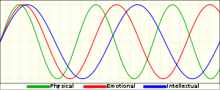

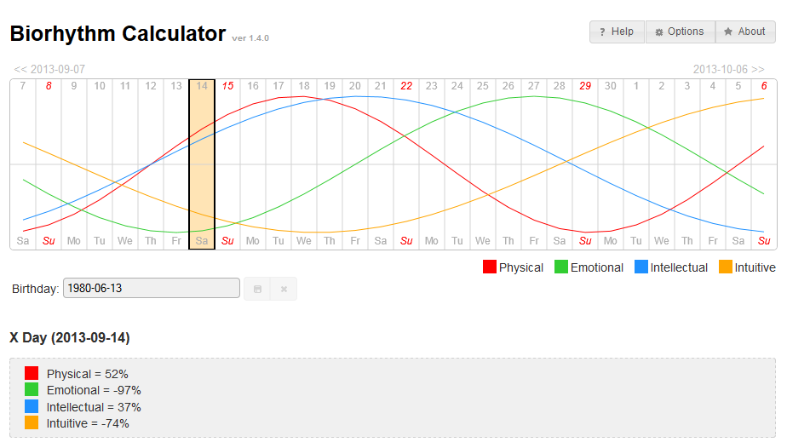
Introduction
What are the biorhythms?
http://en.wikipedia.org/wiki/Biorhythm
What is BioCalc?
[show in browser]

Slide 4
Agenda
Introduction
BioCalc Application
Inheritance
Public, Private, Protected
Adapter Pattern

Slide 5
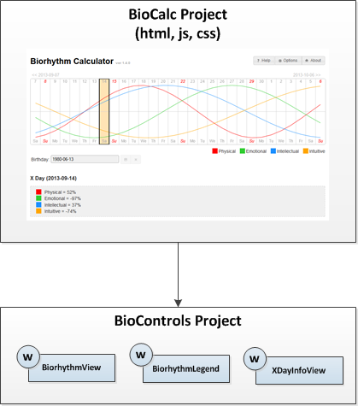
BioCalc Application
[show code]

Slide 6
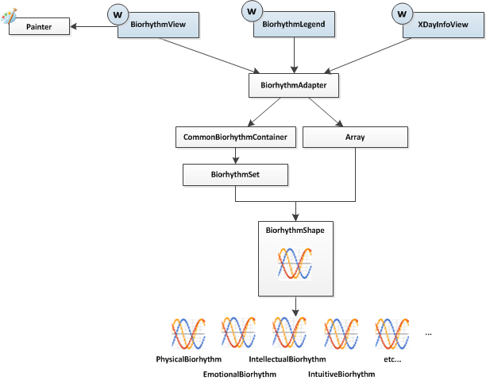
BioCalc Application – BioControls Project
BioControls Project

Slide 7
Agenda
Introduction
BioCalc Application
Inheritance
Public, Private, Protected
Adapter Pattern

Slide 8
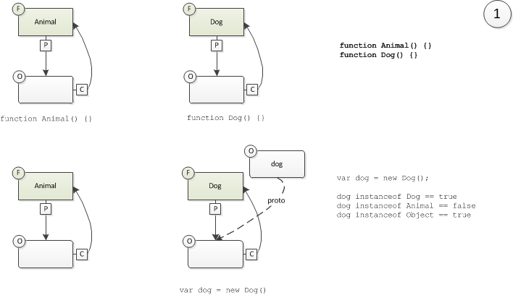
Inheritance – basic
Create two functions (Animal and Dog)

Slide 9
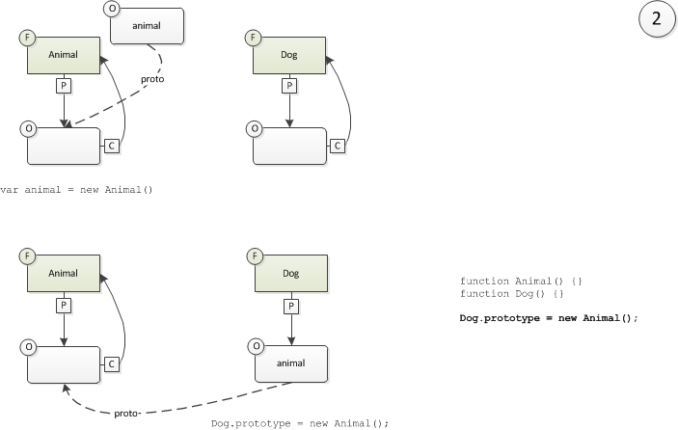
Inheritance – basic
Set the prototype property of the Dog function

Slide 10
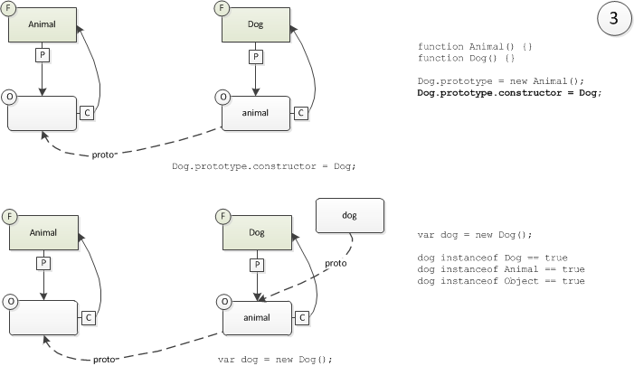
Inheritance – basic
Fix the „constructor” property of the Dog function
But what if...

Slide 11
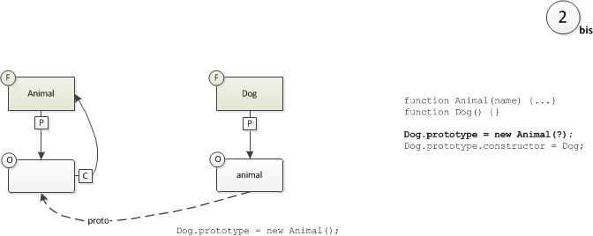
Inheritance – basic
... The prototype’s constructor has parameters
We cannot call the Animal constructor here.

Slide 12
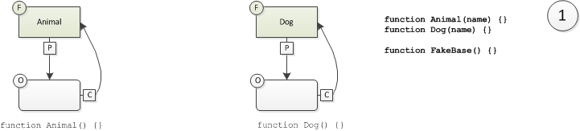
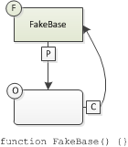
Inheritance – with parameters
Create the constructor function named FakeBase
We’ll use the parameterless FakeBase constructor instead of the Animal constructor.

Slide 13
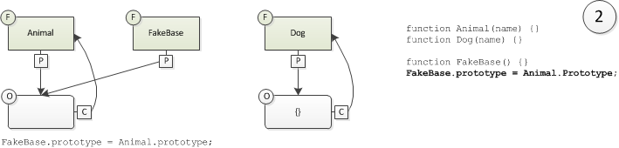
Inheritance – with parameters
Set the prototype property of the FakeBase function

Slide 14
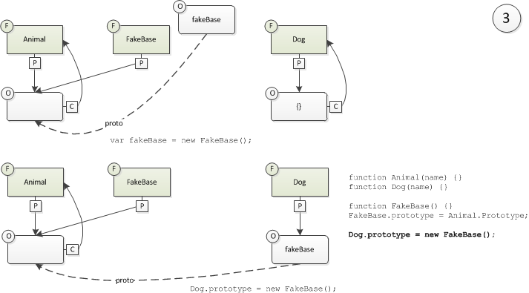
Inheritance – with parameters
Set the prototype property of the Dog function

Slide 15
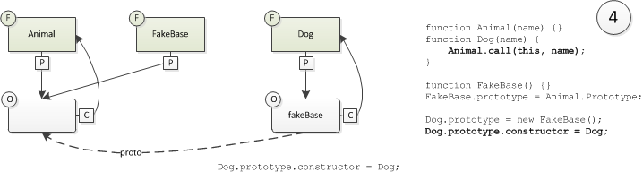
Inheritance – with parameters
Fix the „constructor” property of the FakeBase function
Fix constructor
Call the base constructor from inside the child constructor.

Slide 16
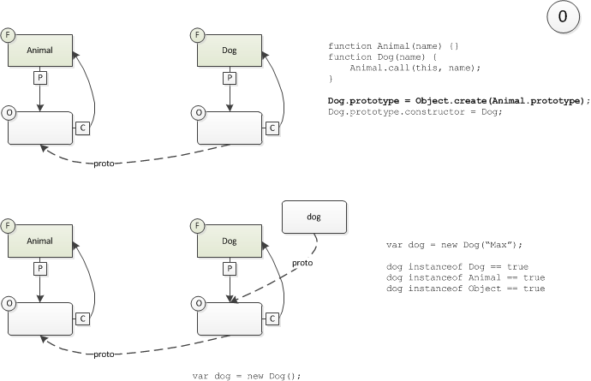
Inheritance – with parameters
In ECMA Script 5

Slide 17
Agenda
Introduction
BioCalc Application
Inheritance
Public, Private, Protected
Adapter Pattern

Slide 18
Public members
How we create public members?
Easy.
[jsfiddle: Virtual public methods]

Slide 19
Private members
How we create private members?
We cannot, but we can emulate.
[jsfiddle: Private methods]

Slide 20
Protected members
How we create protected members?
We cannot.

Slide 21
Alternative to private and protected members
Alternative to private and protected members
Create all members as public and use a naming convention for “private” and “protected” ones.
jQuery uses underscore for “private” members:
Example: this._paint();

Slide 22
Public, Private, Protected
Conclusion
Member type | Can be created
public | yes
private | emulate
protected | no

Slide 23
Agenda
Introduction
BioCalc Application
Inheritance
Public, Private, Protected
Adapter Pattern

Slide 24
Adapter Pattern – Duck Typing
C#
JavaScript
public interface IMyInterface()
{
void MyFunction();
}
We don’t have interfaces
var myObj = obj as IMyInterface;
if (myObj != null)
{
myObj.MyFunction();
}
if (typeof myObj.myFunction === "function") {
myObj.myFunction();
}
“If it walks like a duck and it quacks like a duck then it’s a duck.”

Slide 25
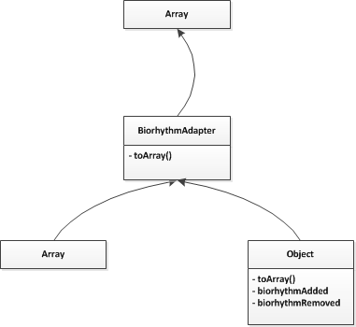
Adapter Pattern
[show code]

